Slide 1
Design of Software Systems CS 509
Fall 2022
Prof. George Heineman
WPI
heineman@cs.wpi.edu

Slide 2
Testing
Systematic attempt to find faults in a planned way in the implemented software
You can’t use testing to prove no defects
Find as many as you can to reduce embarrassment
Fault Detection
Code Reviews
Inspections/WalkThroughs
Execution-based testing

Slide 3
Testing Concepts
Unit
Part of the system that can be isolated for testing
Java: class is smallest unit granularity
Fault [defect]
Design Flaw or implementation Flaw that may cause abnormal unit behavior
Error
Manifestation of a fault during execution. An error leads to failure
Failure
Deviation between specification and actual behavior
Not all errors lead to failures and some can mask each other
Unit
Spec

Slide 4
Testing Concepts
Unit – part of system isolated for testing
Fault [defect]
Design Flaw or implementation Flaw that may cause abnormal unit behavior
Error
Manifestation of a fault during execution. An error leads to failure
Failure
Deviation between specification and actual behavior
Not all errors lead to failures and some can mask each other
Unit
Spec
Unit Under Test
Fault
Error
Failure
Contains
May lead to
May lead to visible
Specification

Slide 5
Testing Process
Test Case
Set of input and expected results that exercises a unit
Purpose is to cause failure and detect fault
Test Stub
Partial implementation of units on which tested unit depends
Test Driver
Partial implementation of unit that depends on the tested unit
Input
Unit
Spec
Output

Slide 6
NPM tests
Testing approach optimized for JavaScript and React
Uses Jest [https://jestjs.io/] built into React
Find info about JavaScript unit testing
https://jestjs.io/docs/getting-started
Find test cases in App.test.js
test('No moves when model created', () => {
var model = new Model(actualPuzzle);
expect(model.numMoves).toBe(0)
});

Slide 7
Unit Testing Options
Can have setup code to execute prior to individual tests
beforeEach(() => { initializeCityDatabase(); }); afterEach(() => { clearCityDatabase(); }); test('city database has Vienna', () => { expect(isCity('Vienna')).toBeTruthy(); }); test('city database has San Juan', () => { expect(isCity('San Juan')).toBeTruthy(); });

Slide 8
Testing classes
Entity class testing
Most traditional
Devise tests to evaluate basic capabilities
Boundary class testing
Not needed – no business logic appears in the GUIs
But you can validate content of the rendered HTML (pretty cool!)
The following ensures that in initial state, the browser renders with “number moves: 0” somewhere in the HTML output
test('Properly renders 0 moves', () => {
const { getByText } = render(<App />);
const movesElement = getByText(/number moves: 0/i);
expect(movesElement).toBeInTheDocument();
});

Slide 9
Testing controllers
Construct model and validate controllers
Anonymous controller functions in App not testable
test('First valid moves', () => {
var model = new Model(actualPuzzle);
var pieceJ = model.puzzle.pieces.find(p => p.label === 'J’)
model.puzzle.select(pieceJ) // INVOKE CONSTRUCTOR
expect(model.puzzle.selected).toBe(pieceJ)
// now what moves are available? only left and right
expect(model.available(Left)).toBe(true)
expect(model.available(Right)).toBe(true)
expect(model.available(Up)).toBe(false)
expect(model.available(Down)).toBe(false)

Slide 10
Testing Boundaries
Can actually write test cases to validate any changes to the externally visible HTML
Note: You won’t have access to internals, since that is “under the hood” and not visible
But for the group project I encourage you to be more ambitious

Slide 11
Executing Test Cases
Launch npm test
You may have to type ‘a’ to run all tests
May take up to minute
Shows each test case, by descriptions
describe() can create separate suites
describe('matching cities to foods', () => { // Applies only to tests in this describe block beforeEach(() => { return initializeFoodDatabase(); }); test('Vienna <3 veal', () => { expect(isValidCityFoodPair('Vienna', 'Wiener Schnitzel')).toBe(true); }); test('San Juan <3 plantains', () => { expect(isValidCityFoodPair('San Juan', 'Mofongo')).toBe(true); }); });

Slide 12
Code Coverage
Goal is to ensure 80% code coverage of src folder
This can be achieved!
Incrementally, a bit at a time, and you can hit this target
Do not attempt 100% code coverage
Waste of your time and resources
Some class code only executes with user in front of computer
Launch as npm test -- --coverage for this capability
BUT FIRST! You need to set environment variable CI=true
Gosh that is annoying

Slide 13
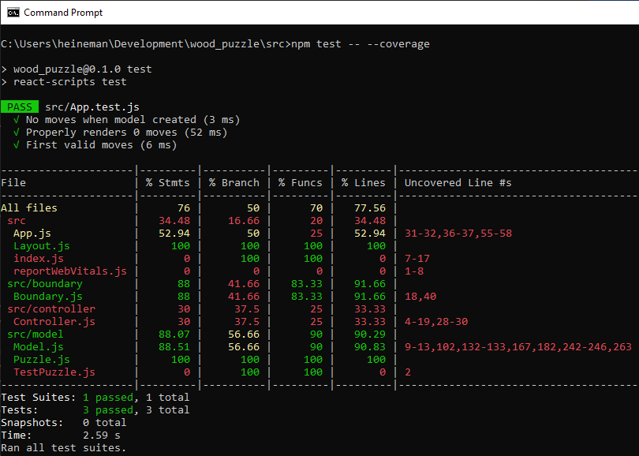
Report
Goal is to get src/ to show 80.0%

Slide 14
Possible To Write GUI test cases
test('Access GUI', () => {
const wrapper = render(<App />);
const leftButton = screen.getByTestId('leftbutton');
const rightButton = screen.getByTestId('rightbutton');
const canvasElement = screen.getByTestId('canvas');
// initially, this button
expect(leftButton.disabled).toBeTruthy()
expect(rightButton.disabled).toBeTruthy()
// this chooses bottom piece
fireEvent.click(canvasElement,
{ screenX: 436, screenY: 573, clientX: 184, clientY: 440});
// now this button is NOT disabled
expect(leftButton.disabled).toBeFalsy()
expect(rightButton.disabled).toBeFalsy()
});

